Slide 1
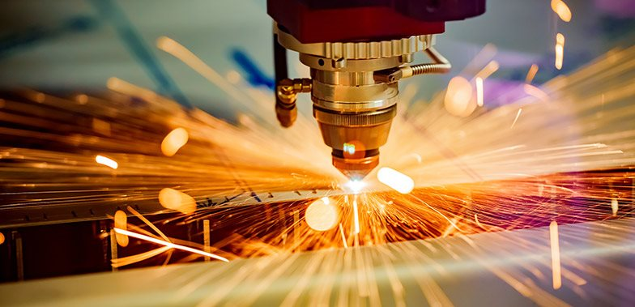

DIGITAL FABRICATION
REPORT

Slide 2
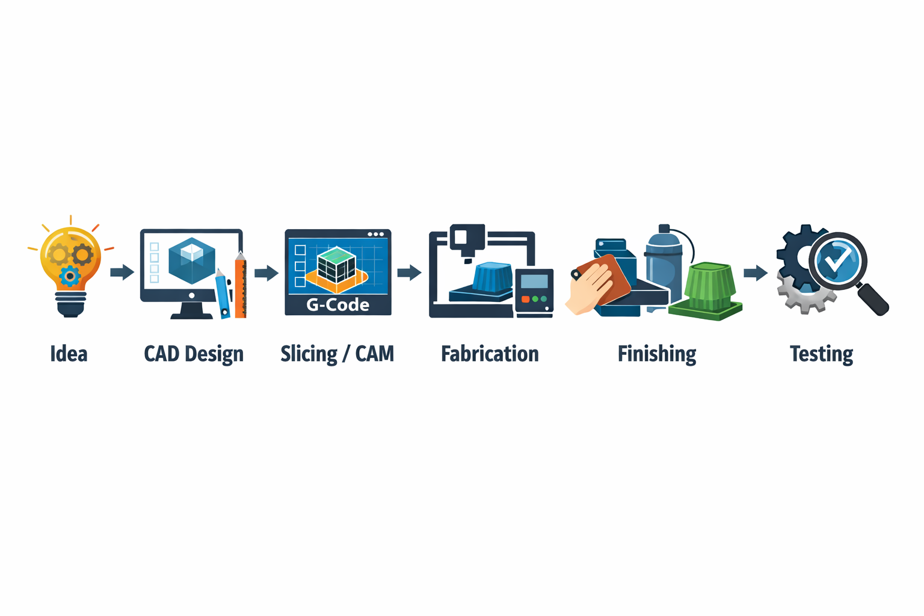
Digital Fabrication
Digital fabrication is the process of designing objects using computers and manufacturing them using digital-controlled machines such as 3D printers, CNC machines, and laser cutters.
Steps in digital fabrication :-

Slide 3
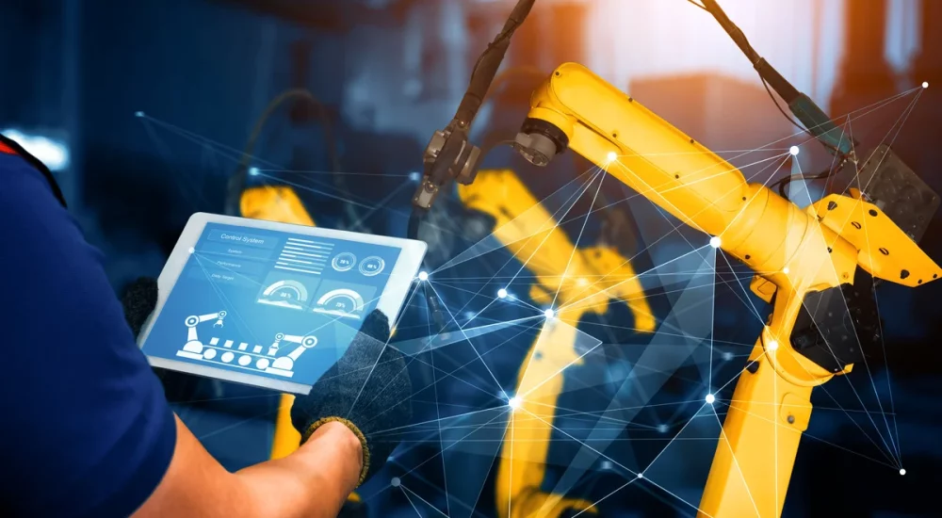
1940s–1950s: Origins of CNC
1940s–1950s — Origins of CNC
John T. Parsons & Frank L. Stulen developed early Numerical Control (NC) machines.
Machines were operated using punched cards instead of manual control.
This laid the foundation for modern computer-controlled manufacturing.
John T. Parsons and Frank L. Stulen developed the first numerical control (NC) machines using punched cards to automate machine tools, laying the foundation for computer-controlled fabrication.

Slide 4
1940s–1950s: Origins of CNC
1940s–1950s — Origins of CNC
John T. Parsons & Frank L. Stulen developed early Numerical Control (NC) machines.
Machines were operated using punched cards instead of manual control.
This laid the foundation for modern computer-controlled manufacturing.
1960s–1970s —
CAD/CAM
Development
Introduction of computers into design and manufacturing.
Engineers could create digital models using CAD.
These designs were converted into machine instructions using CAM.
Widely adopted in aerospace and automobile industries.
1980s — Birth of 3D
Rapid Prototyping
1981: Hideo Kodama proposed layer-based 3D modeling.
1986: Chuck Hull invented and patented Stereolithography (SLA).
Objects were built layer by layer instead of cutting material away.
Initially used mainly for prototypes.
1990s–Present —
Maker Movement
and Advanced
Fabrication
RepRap project made low-cost, self-replicating 3D printers.
Growth of Fab Labs and Makerspaces worldwide.
Today includes robotics, construction 3D printing, and smart factories (Industry 4.0).
John T. Parsons and Frank L. Stulen developed the first numerical control (NC) machines using punched cards to automate machine tools, laying the foundation for computer-controlled fabrication.

Slide 5



SIGNIFICANCE OF DIGITAL FABRICATION
1.
2.
3.
Faster and More Accurate Manufacturing
Machines are controlled by computers, so production is much faster.
Reduces human error compared to manual methods.
Ensures high precision and consistent quality in every product.
Shortens the time from design to final product.
Flexibility and Complex Design Capability
Digital fabrication can create very complex shapes and structures that are impossible with traditional machines.
Designers can easily modify designs on a computer without remaking tools.
Supports multi-material and lightweight designs.
Widely used in architecture, aerospace, and advanced engineering projects.
Cost-Effective and Sustainable Production
Reduces material waste by using only what is needed.
Lowers manufacturing and labor costs, especially for small batches.
Supports lightweight and eco-friendly designs.
Helps small businesses and startups create products at low cost.

Slide 6
Basic Terminologies in Digital Fabrication
CAD
Computer-Aided Design: Using software to create 2D or 3D digital models.
SolidWorks, Fusion 360, AutoCAD
Computer-Aided Manufacturing: Software that translates CAD designs into machine code (G-code).
CAM
Mastercam, Cura (Slicer)
CNC
Computer Numerical Control: Automated control of tools by a computer program.
CNC Mill, CNC Router
Additive Mfg.
Building objects by adding material layer by layer.
FDM 3D Printing, SLA
Subtractive Mfg.
Creating objects by removing material from a solid block.
Laser Cutting, Milling, Turning

Slide 7


Safety and Protocols in CAD Lab, Workshop & Industrial Visits
1.
2.
3.
In CAD Lab
Sit properly and maintain posture
Do not touch wires or electric connections
Save work regularly
Follow lab instructions
Do not install unauthorized software
In Workshop
Wear safety goggles, gloves, and apron
Do not wear loose clothes
Keep hands away from moving machines
Follow instructor’s instructions
Switch off machines after use
During Industrial Visit
Follow all company safety rules
Wear helmet and safety shoes if required
Do not touch machines
Maintain discipline and silence
Stay with your group
Observe and take notes carefully

Slide 8
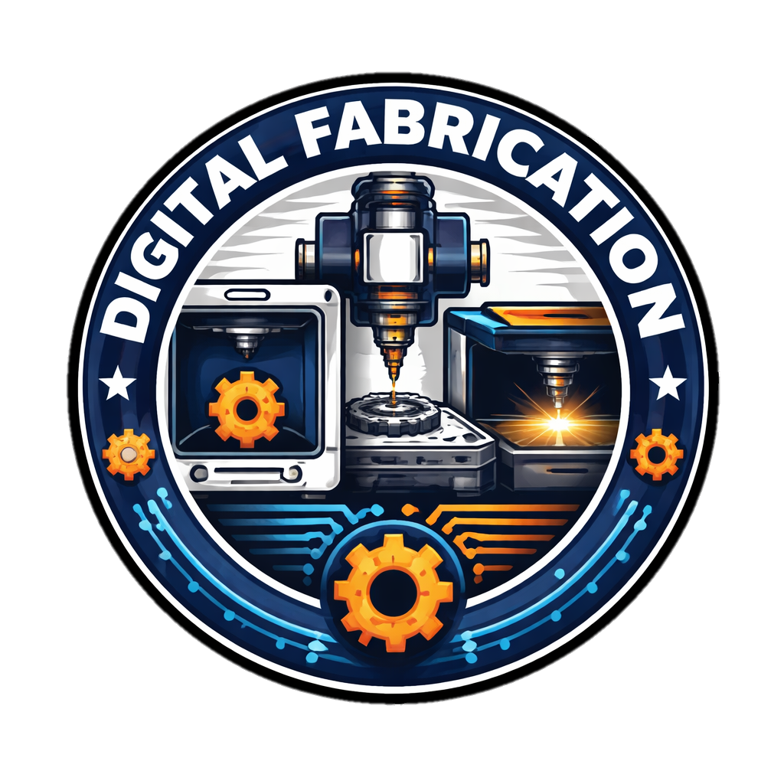
Guidelines for Group Design & Fabrication Projects
Leader, Designer,Fabrication in-charge
Documentation in-charge
Documentation
Maintain project file
Record all steps
Add diagrams and photos
Clear Role Distribution
Define problem clearly
Make design plan
Set timeline and deadlines
Documentation
Proper Planning
Testing and Improvement
Communication
Test prototype
Identify errors
Improve design
Use of Digital Tools
Regular group discussions
Share ideas and improvements
Use CAD software for design
Use simulation before fabrication

Slide 9
THANK YOU

